Slide 1
Functions and the Call Stack
Notes:
We saw that when a program has functions, control doesn’t move linearly from the top of a program to the bottom.
It has to jump sometimes, into a function, back out of a function.
How does Python know where to send control next?
It turns out that there is a special object that keeps track of where Python is executing, and that object is called the call stack or the execution stack.

Slide 2
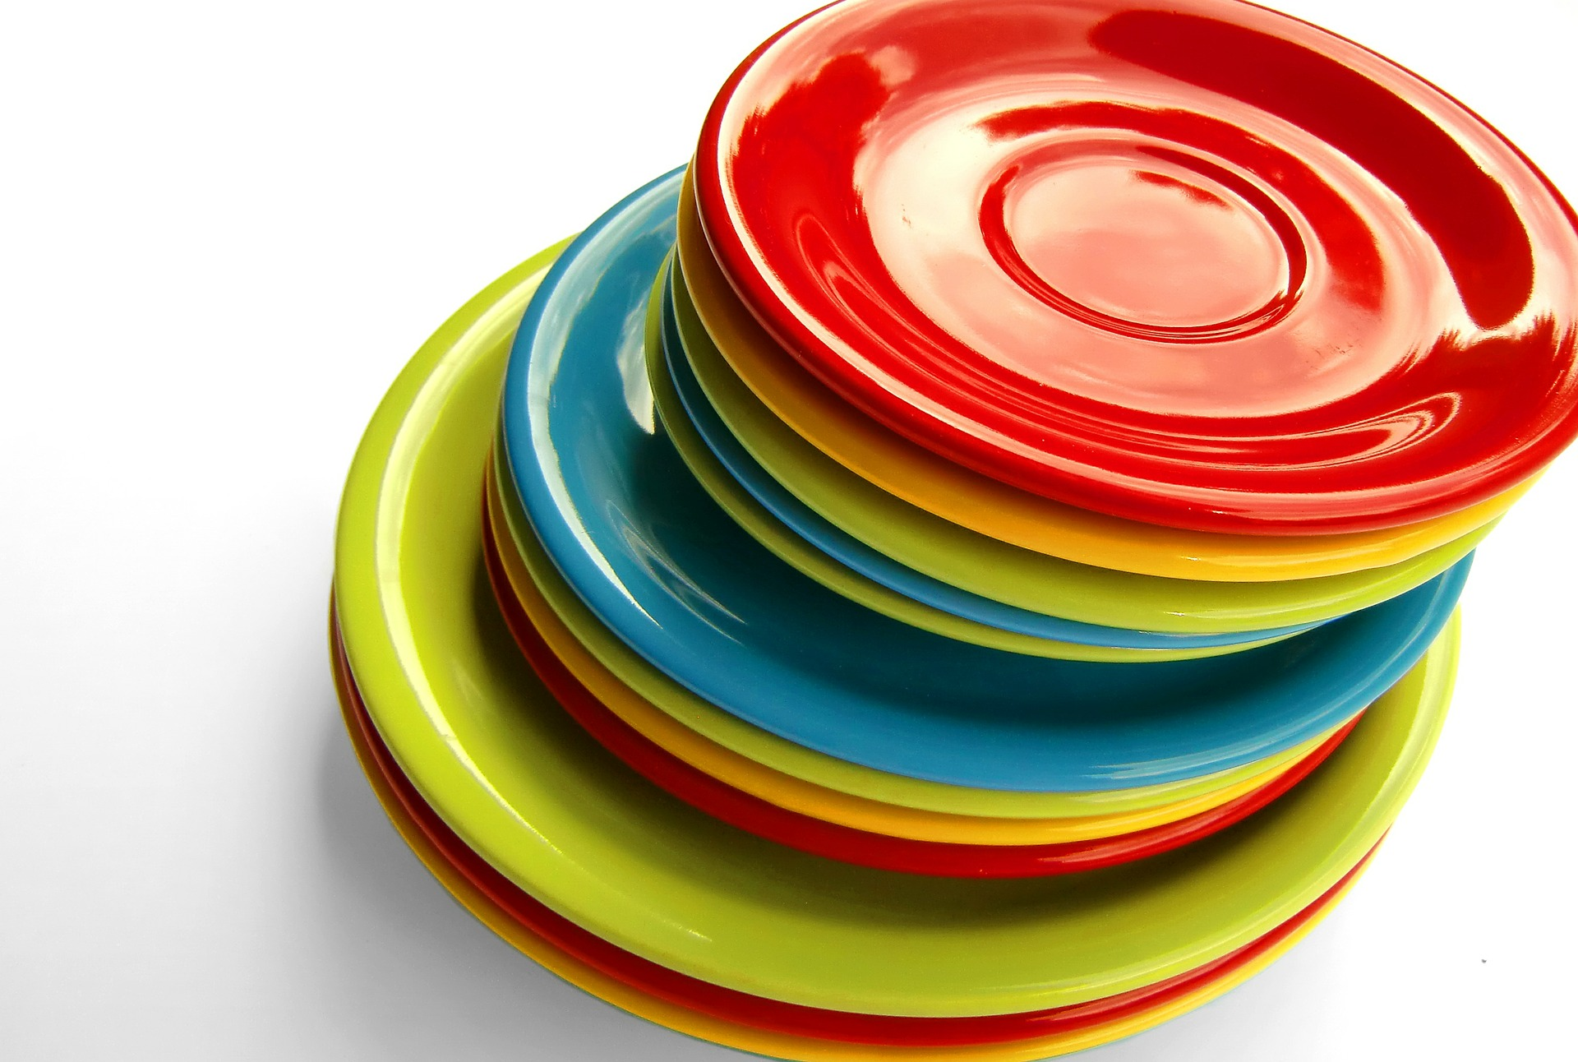
Stack
Notes:
When you hear stack, you might imagine a stack of plates. And that really is similar to the call stack. What can you do with this stack of plates? Imagine that you can add a plate to the stack, and you can remove the last plate that was added to the stack. But you’re not allowed to reach into the middle of the stack to get a plate, you can only get the plate that was added last.
In our case, each plate is called a stack frame, and it represents one location in the program where we’re executing.

Slide 3
Call Stack
In Main at line 25
Notes:
When you start a program, there’s only one stack frame—the one that tells us where we’re executing the main script. It will also remember the location we’re at. In this case, we’re at line 25.

Slide 4
Call Stack
In Main at line 25
In geometric_mean at line 12
Notes:
What happens when we enter a function? Let’s say we call a function called geometric_mean.
We can’t forget where we are in the main program - we have to leave that stack frame alone.
Instead, we add a new frame to the stack. In this case, I’m adding it to the bottom, because that’s how python displays it.

Slide 5
Call Stack
In Main at line 25
In geometric_mean at line 12
Notes:
Now the call stack looks like this.

Slide 6
Call Stack
In Main at line 25
In geometric_mean at line 15
In sqrt at line 8
Notes:
what if we’re inside our geometric_mean function and we reach another function call? Let’s say we call a sqrt function. then we have to pause execution in geometric mean and add another frame to the stack.

Slide 7
Call Stack
In Main at line 25
In geometric_mean at line 15
In sqrt at line 8
Notes:
Now the stack looks like this. When you see this, you know that control is currently executing in sqrt.
What happens when we reach the return statement?
We have to back out, so the last frame gets popped off of hte stack.

Slide 8
Call Stack
In Main at line 25
In geometric_mean at line 15
In sqrt at line 10

Slide 9
Call Stack
In Main at line 25
In geometric_mean at line 15
Notes:
What if we reach the end of geometric_mean? then we have to pop that frame off of the stack.

Slide 10
Call Stack
In Main at line 25
Notes:
At this point, only the main frame is left, and the program can finish.

Slide 11
Hint
Functions are like separate programs, running side by side.
Notes:
This is a good comparison. A function is very much like a separate program within a program. We’ll see that it has a lot of the same elements that we know an entire program has.

Slide 12
Functions and the Call Stack

